Slide 1



CS431 – Mobile Computing and
Application Development
By Group 1
Ameera Almohammdi 3752744
Hind Alharbi 3453382
Maryam Alraddadi 3752699
Omamah Alrehaili 3752216
Sana Qarah 3752533
HOTEL RESERVATION SYSTEM

Slide 2
OUTLINE
INTRODUCTION
Project Objectives
Benefits of the application
Project Timeline
Team Organization
SYSTEM ANALYSIS
Requirements Elicitation
Developmental Methodology
SYSTEM DESIGN
Object Oriented Design
Project Map
User Interface Design
SYSTEM IMPLEMENTATION
Tools and Languages
SYSTEM TESTING
GOALS ACHIEVED & FUTURE WORK

Slide 3

INTRODUCTION

Slide 4




IDEA
a hotel reservation application that aims to deliver easy to use, fast booking experience.
NAME
النَّزِيلُ : الضَّيفُ
LOGO
+ + =
HOTELS
ANYWHERE
ANYTIME
REVIEWS
Notes:
The logo design reflects the application features

Slide 5


PROJECT OBJECTIVES
To develop a mobile application that allows the user to search for a hotel room and book it or cancel a reservation online at any time.
To design and implement a database to integrate with the application.

Slide 6

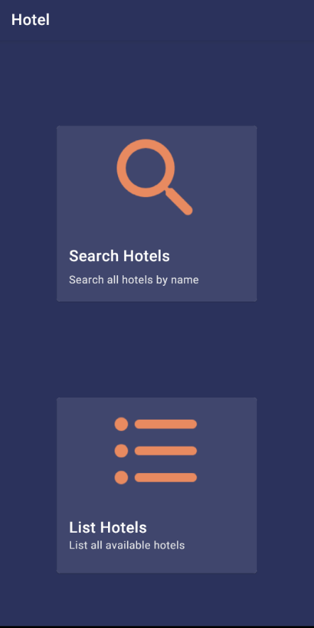
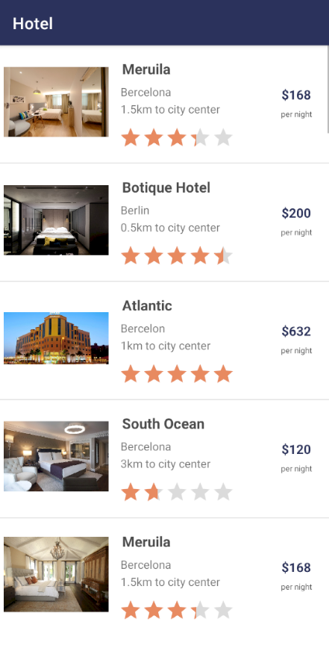
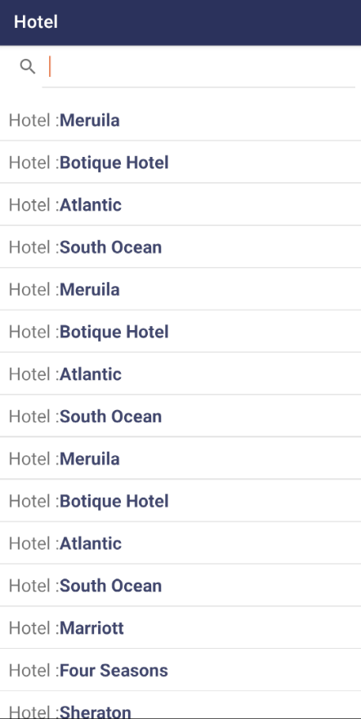
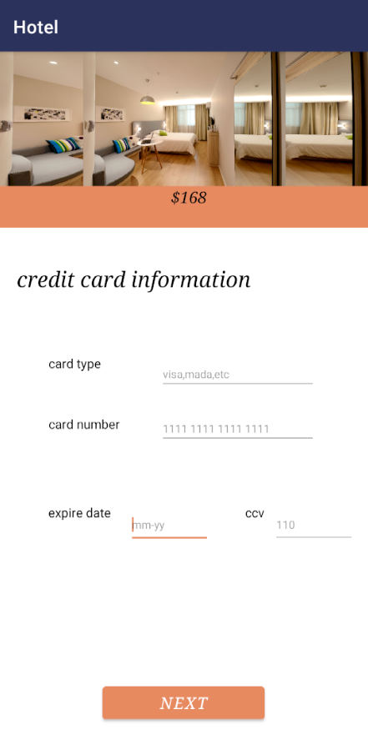
BENEFITS OF THE APPLICATION
Ease of use
Informative
Time saving
Complete booking process

Slide 7
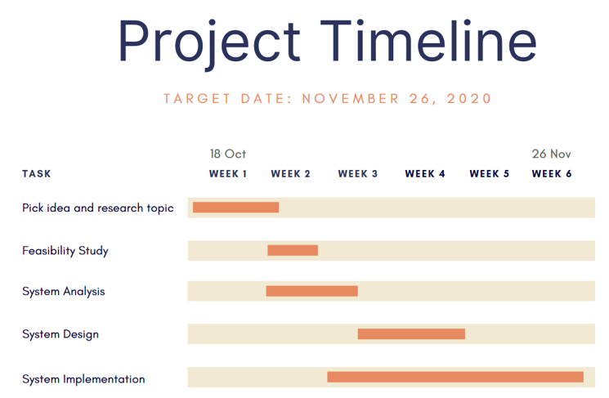
PROJECT TIMELINE
Our plan to achieve the project objectives in approximately 6 weeks.

Slide 8
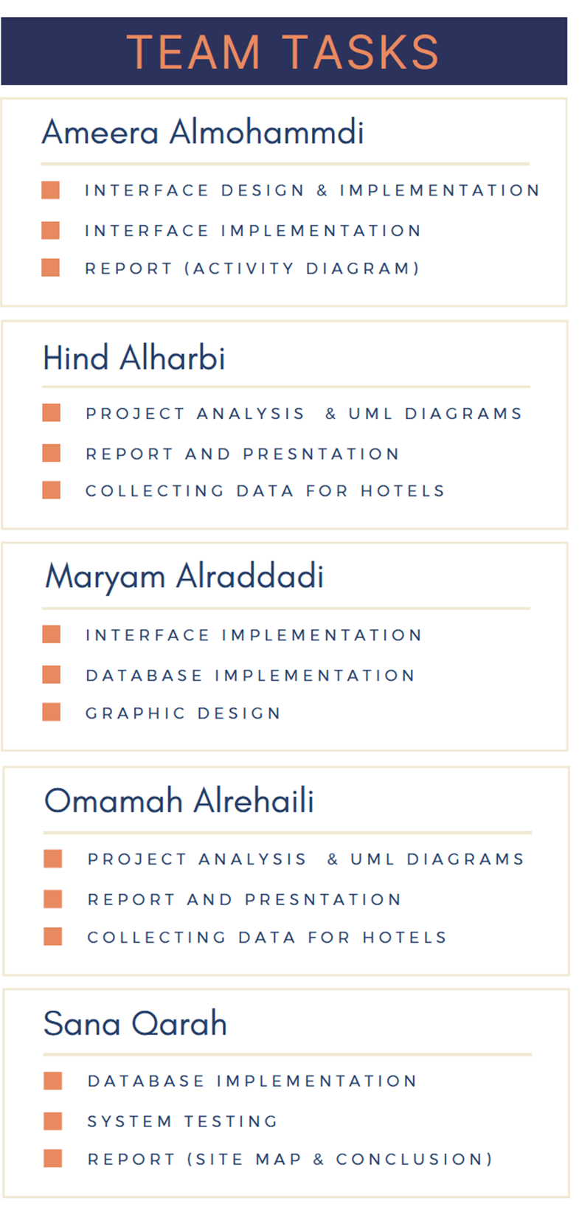
TEAM ORGANIZATION

Slide 9
SYSTEM ANALYSIS

Slide 10
Functional Requirements
Functional requirements state what the system should do to which users and defines the services provided by the system:
The user should search for the available room (based on price, hotel, city, and rating).
The user should be able to cancel the reservation.
The user should be able to put room booking details.
The user should be able to pay online.
The administrator should be able to insert hotels details.
The administrator should be able to manipulate the system database.

Slide 11
Nonfunctional Requirements
The application should have an intuitive user interface that is easy to use. | Usability
The system should be available most of the time and updated automatically from the database. | Availability
The system should be security and follow security best practices when handling user passwords, payments, and other user information. | Security

Slide 12
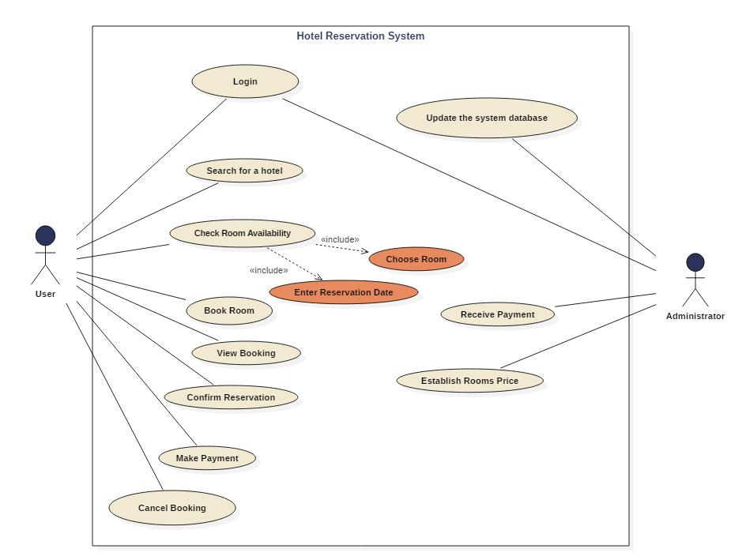
Use Case Diagram
The use case diagram presents the set of functionalities, different types of actors and their relationship. It describes the goal of the system and the actor interactions with the system.

Slide 13
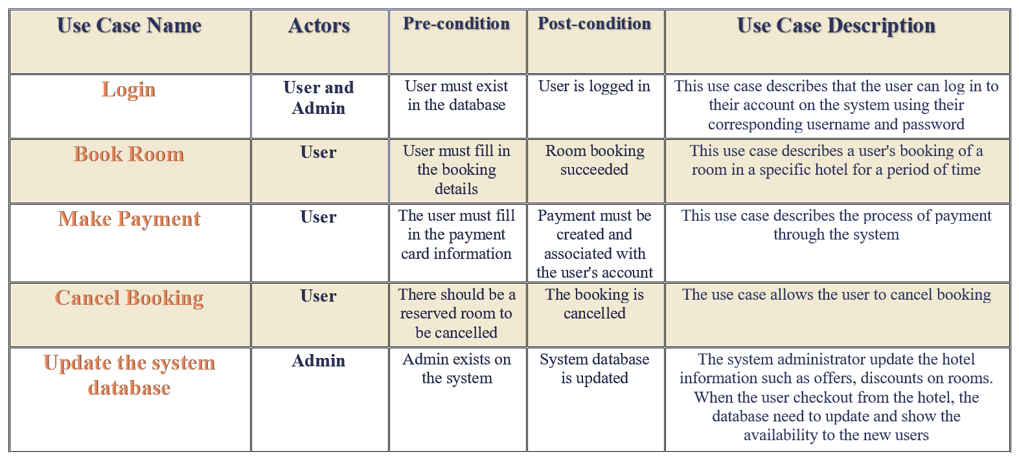
Use case description

Slide 14
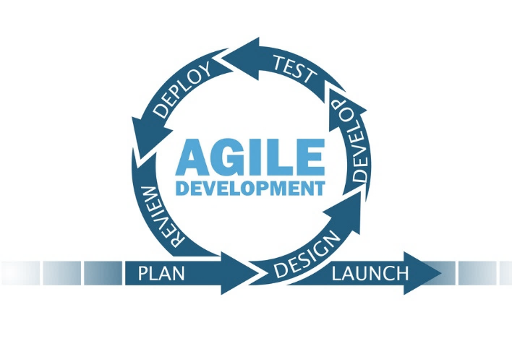
Project methodology
Plan: In this stage, all the project features will be prepared, and know what will be built depending on the project delivery term.
Design: At this stage, the design begins with the existing system and requirements structure and the UML design to visualize what needs to be followed during the development phase.
Development: This stage adopts the system by starting to implement the database and application interfaces.
Testing: The testing phase will only begin when the entire development process is complete, check to ensure that the app is running properly without errors and functions are working as expected.
Release: A trial version of this stage of the product for users.
Feedback: This stage is to collect feedback about the system from users and work to improve it

Slide 15
SYSTEM DESIGN

Slide 16
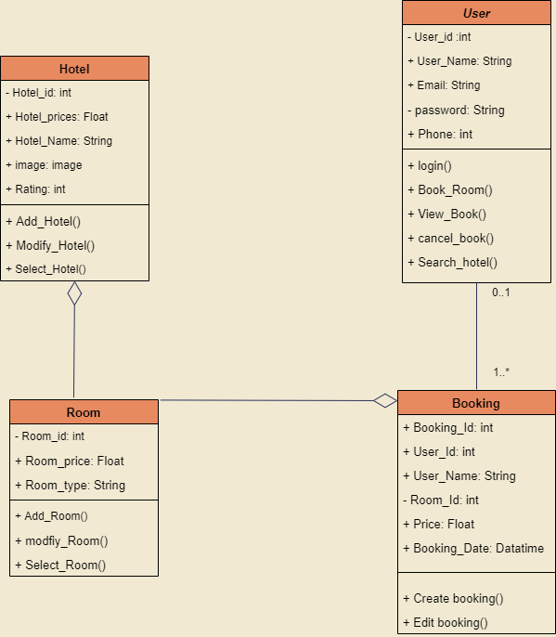
Class Diagram
Structural model represents how the entities are organized in the system. The class diagram is the most commonly used model. It represents the elements and the relationship between them.

Slide 17
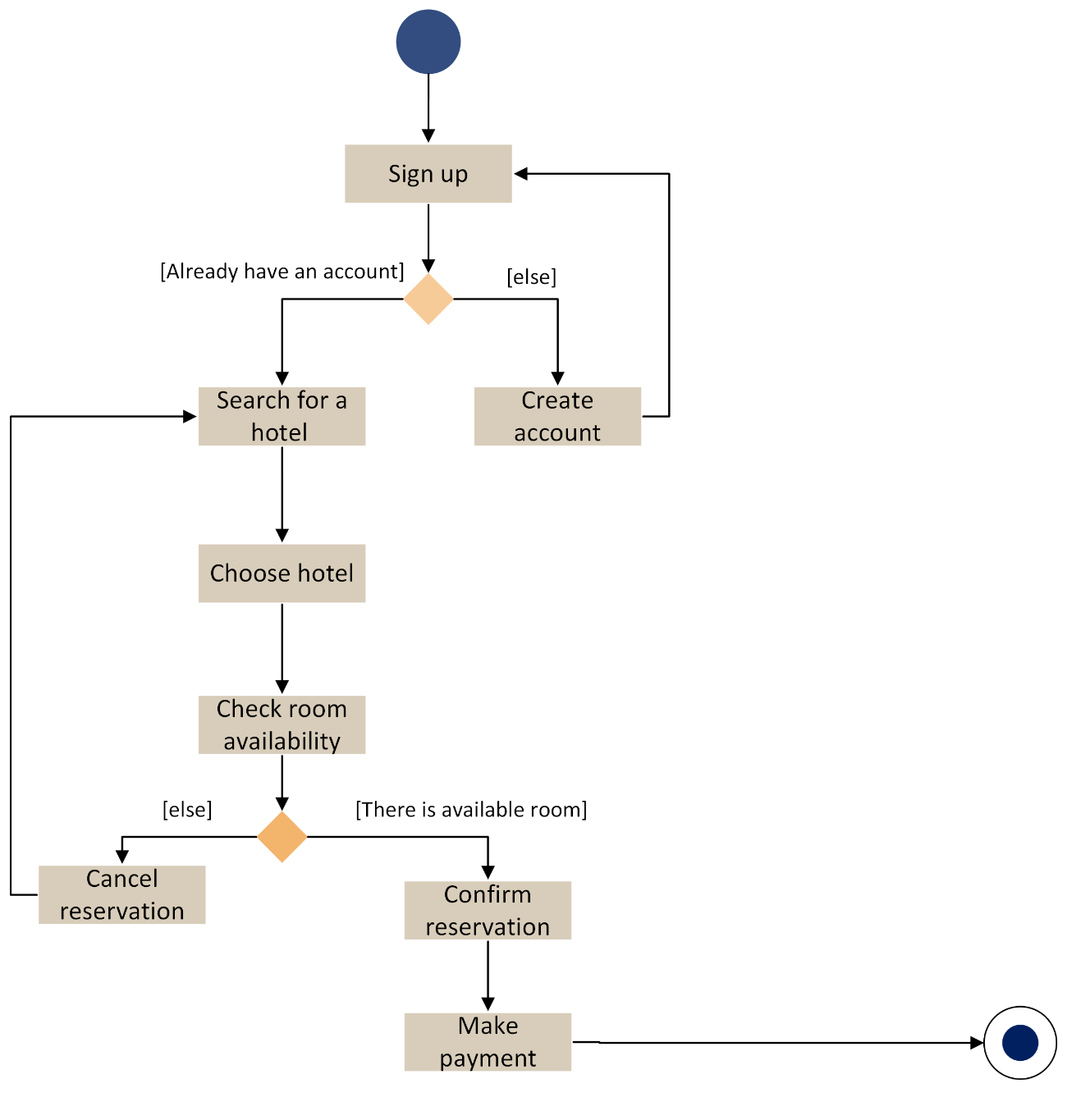
Activity diagram
Activity diagram is a dynamic model that is used to show the control flow from the start circle to the end. It focuses on the consecutive functional activity of the system. Figure 6 starts with the sign-up activity and shows the order of sequential functions.

Slide 18
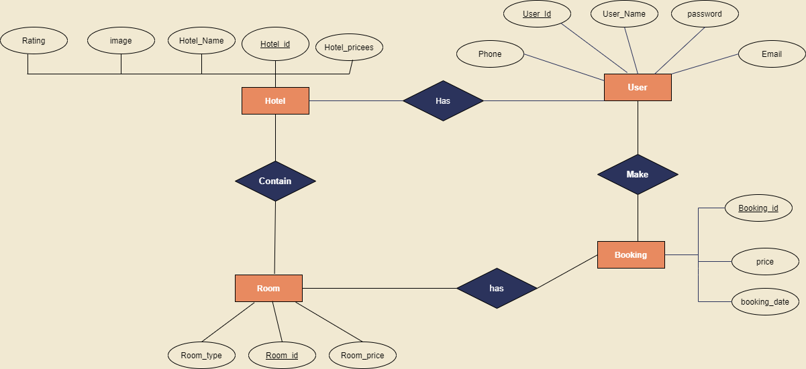
ER Diagram
Database design is organizing the data in models. This design is used to store and manage the data and their relationships in a database. Using database models makes it easier and simpler to read

Slide 19
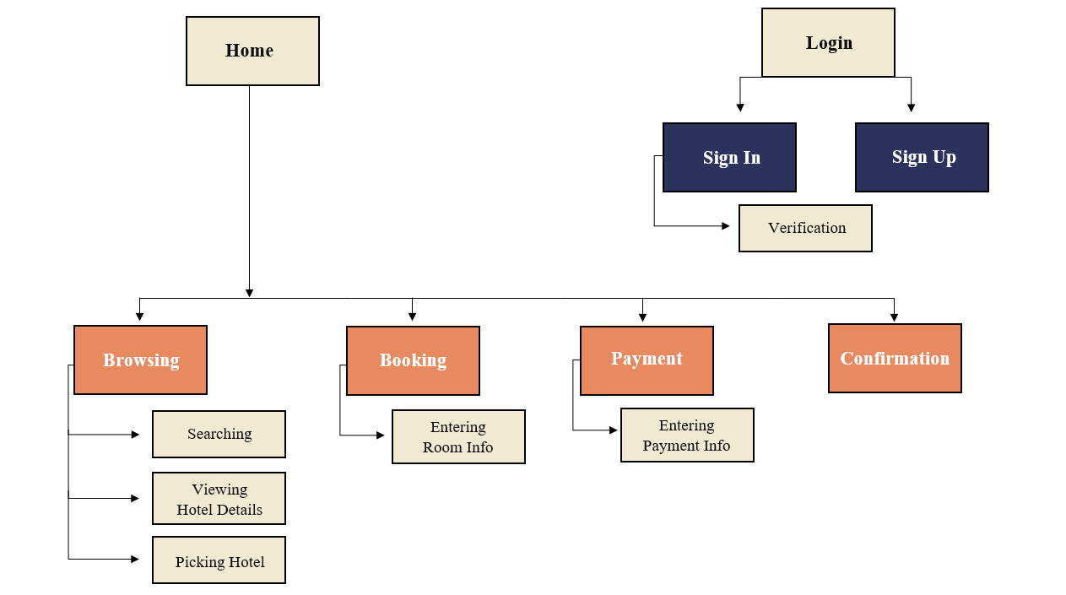
Project Map
The project site map used to show the activities within the application, and details each of these activities. The diagram provides information about all pages and shows the connections between them.

Slide 20
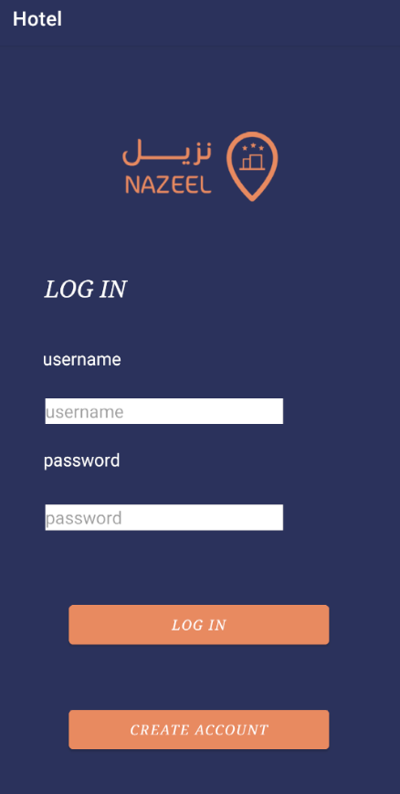
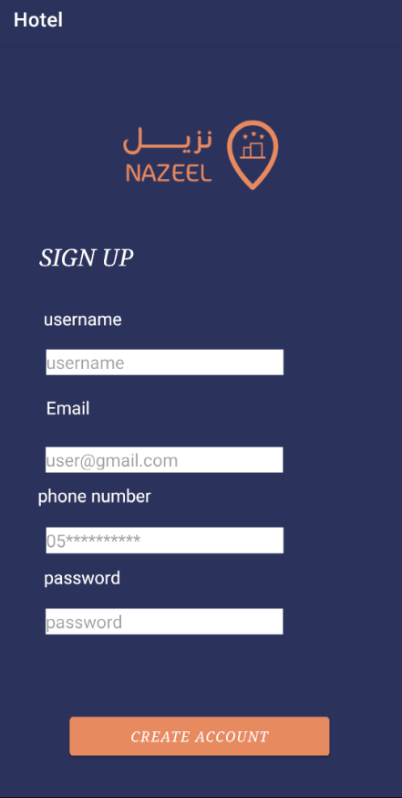
User Interface Design
Sign in page
Sign up page
Home page
Search page

Slide 21
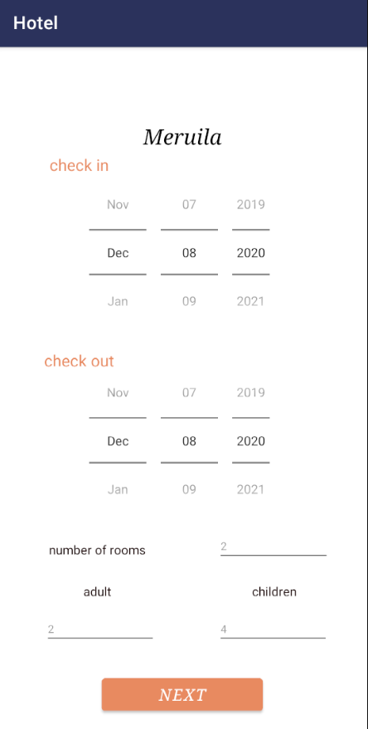
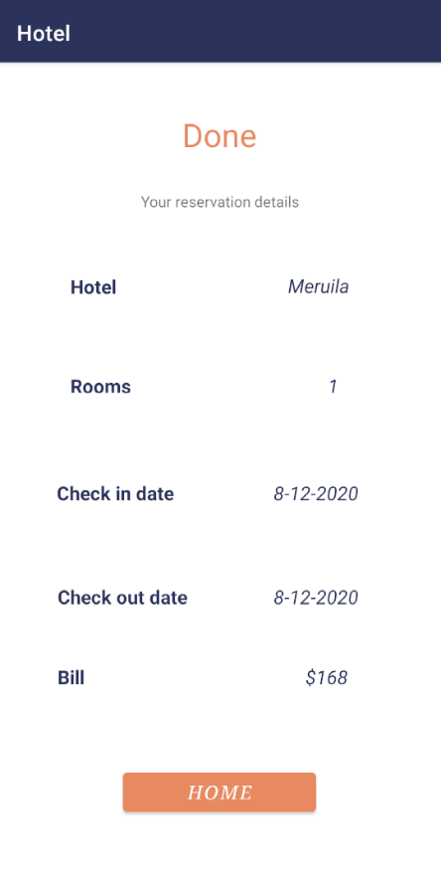
User Interface Design
Hotels list
Booking page
Payment page
Confirmation page

Slide 22
SYSTEM IMPLEMENTATION

Slide 23
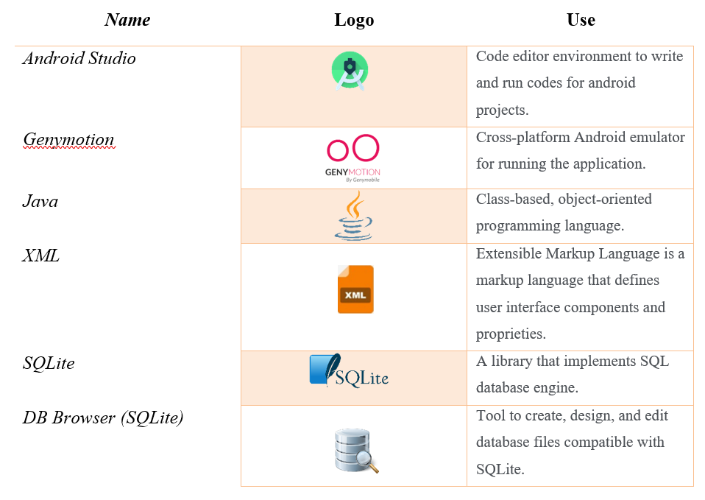
Tools and Languages

Slide 24
SYSTEM TESTING

Slide 25
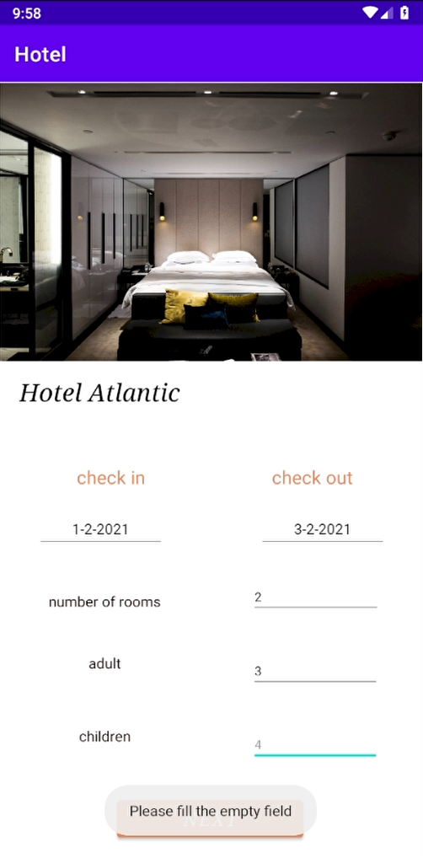
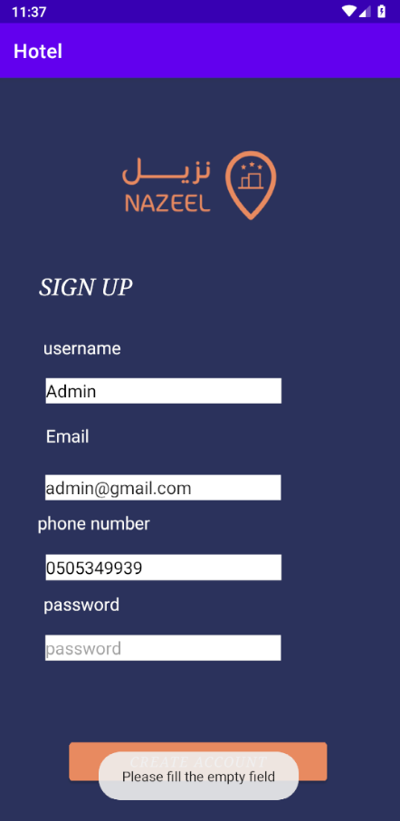
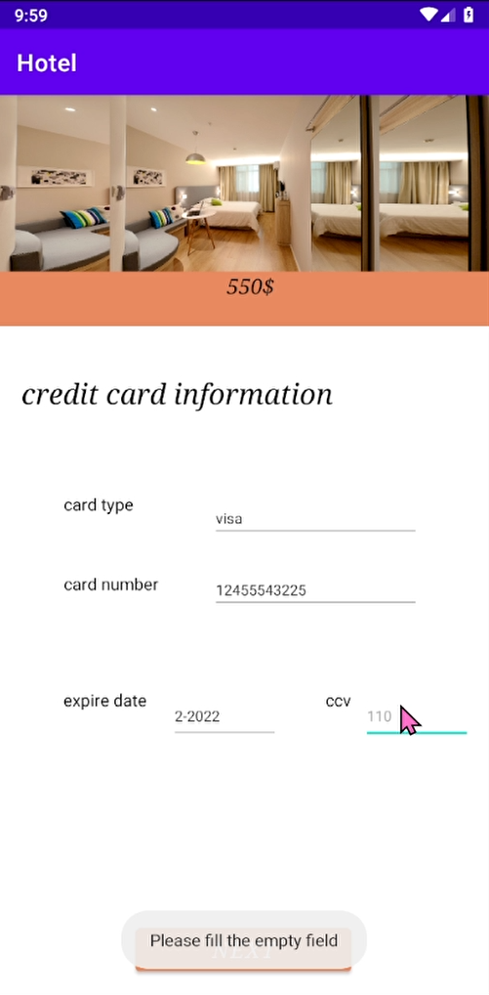
Empty Field Testing
In sign up, room booking page, and payment page, when user skip a field without filling it, navigation cannot be done, and a message shows up indicating the mistake

Slide 26
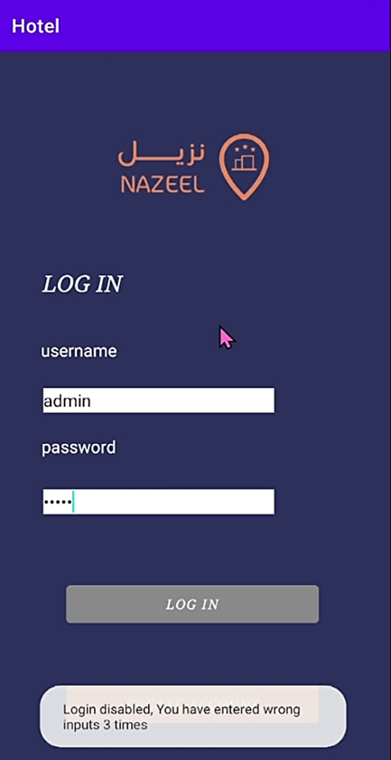
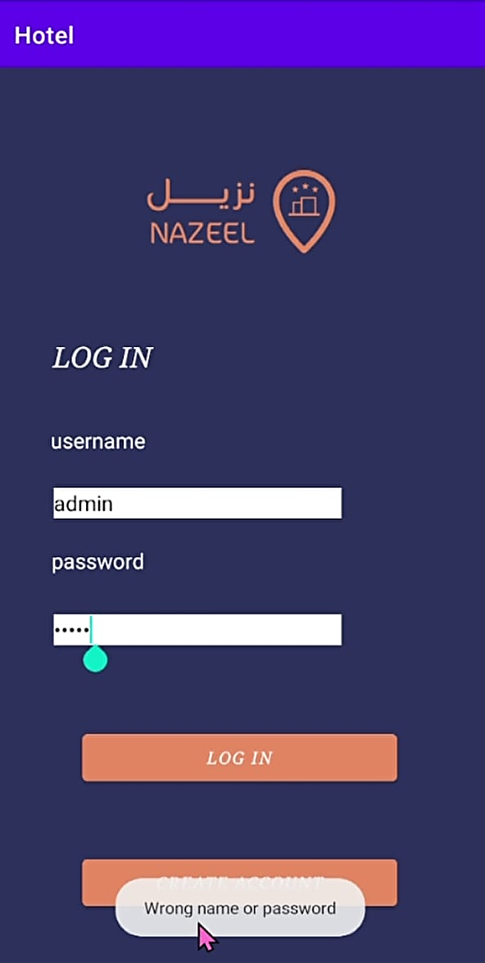
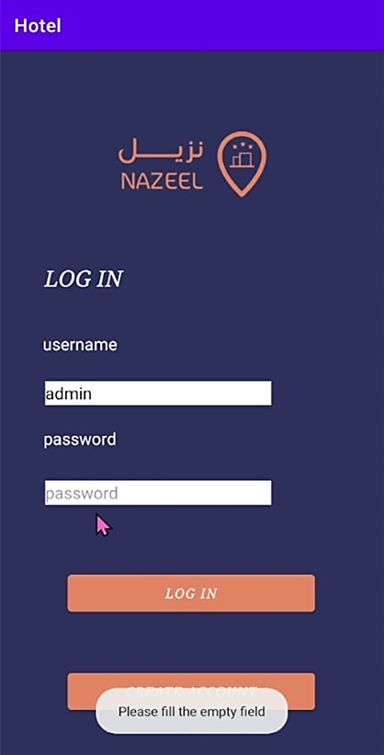
Login Testing
In sign in, when user skip a field without filling it, sign in cannot be done, and a message shows up indicating the mistake. The same happens when user enters wrong username or password.
If when user enters wrong data 3 times, the application will assume someone else is trying to enter the real user’s account and will disable login button.

Slide 27
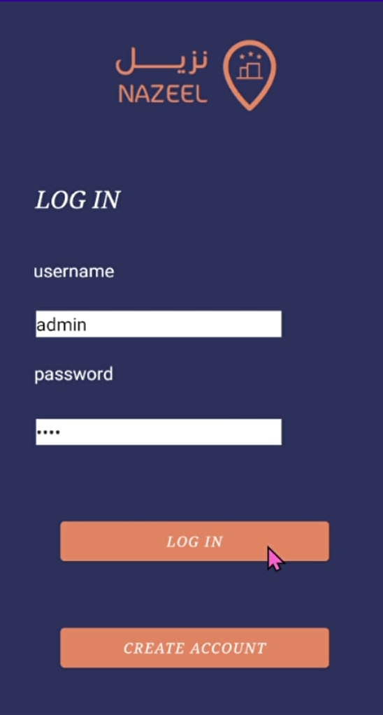
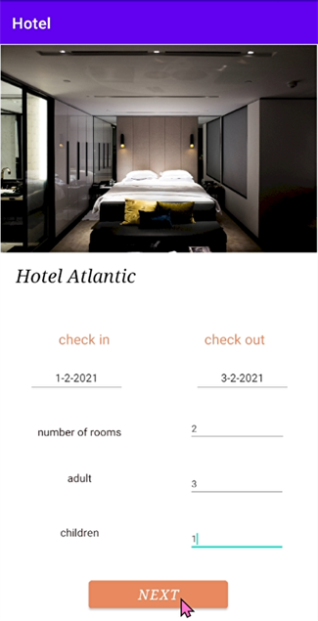
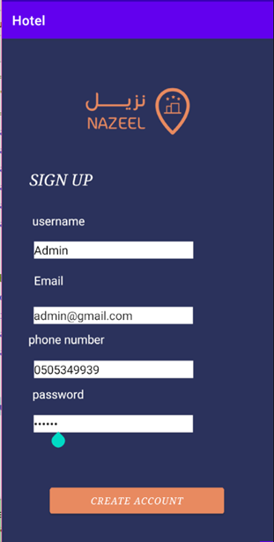
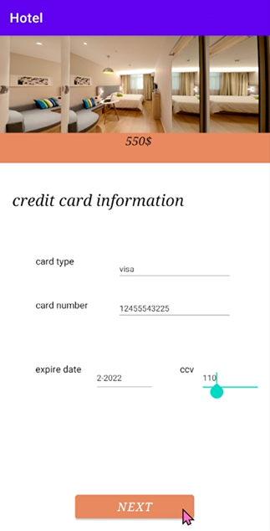
The right testing:

Slide 28
CONCLUSION AND FUTURE WORK

Slide 29
Conclusion
The main purpose for this project was to develop a small hotel reservation application for android platform to help visitors in booking and paying for their choosing hotel. The project starts with the fourth main development phases (system analysis, system design, system implementation, and system testing and maintenance). The project results an easy to use application with a simple interface and the educational purpose was also achieved.

Slide 30
Goals Achieved
The main goals archived in this project was pre-decided and oriented including the following:
Choosing the name and creating the logo.
Dividing members tasks and project stages overtime.
Introducing the project and placing its objectives and describing its benefits and functions.
System analysis and use case diagram.
System design with the structural and dynamic views.
System implementation (front end and backend).
System testing for all possible inputs.

Slide 31
Future Work
For the future improvements, the application is going to support all platforms other than android, and the hotel owner would be able to sign in as a user and insert the hotel after admin’s permission, rather than inserting hotels by the admin himself.

Slide 32
Thank you

